Slide 1

LRM/RDA/BIBFRAME
Or The alphabet soup that keeps Joy up at night….

Slide 2
IFLA Library Reference Model (LRM)

Slide 3
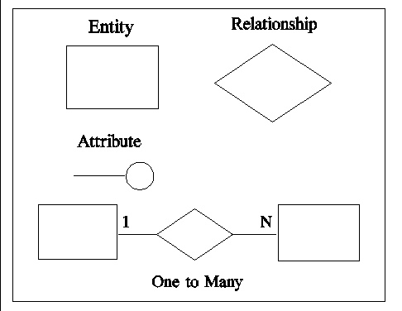
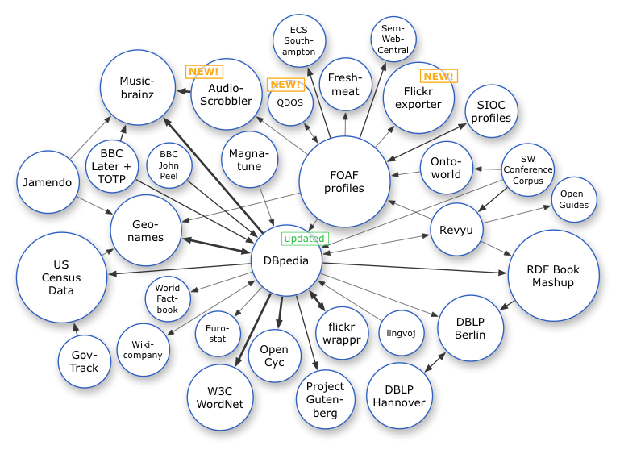
What is LRM?
>IFLA’s new high-level conceptual data model for bibliographic information for libraries and cultural communities
>Based on entity-relationship model
>Designed to work with Semantic Web technologies

Slide 4
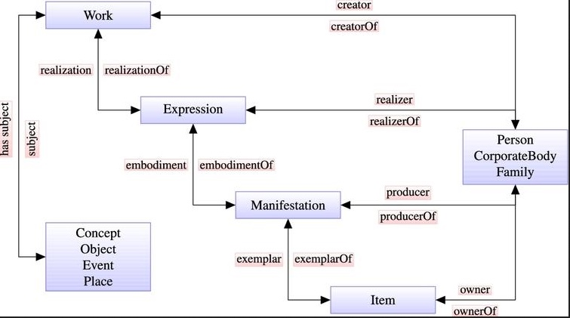
LRM – Definition (Continued)
LRM harmonized separate FRBRs into one unified model:
>Functional Requirements for Bibliographic Records (FRBR)
>Functional Requirements for Authority Data (FRAD)
>*Functional Requirements for Subject Authority Data (FRSAD)→Relationship
BEFORE LRM – Three Separate Models
>New! Absorb holding, name and subject data into the model
>New! Incorporate serials and other continuing resources into the model as ‘aggregates’.

Slide 5
Renamed to IFLA LRM in 2016
Published/updated in August 2017
Local impact:
RDA’s Redesign & Restructure – June 13, 2018

Slide 6
LRM – Entity Relationship Models (Elements)
entities, the classes
attributes, the data which characterizes instances of entities
relationships, the properties which link instances of entities

Slide 7
Some New Key Concepts

Slide 8
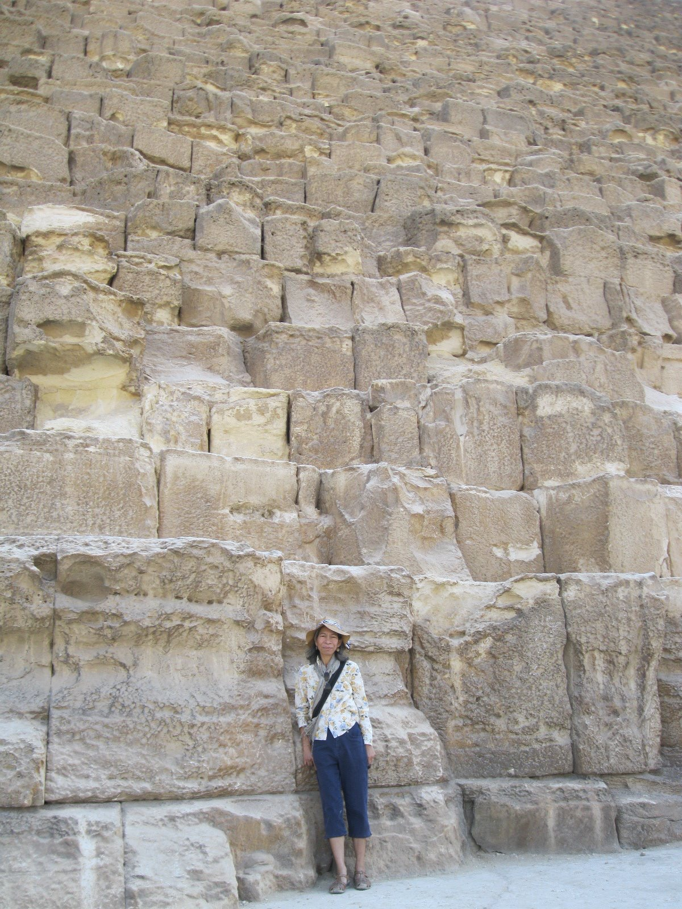
RDA entity (the “Thing”) ≠ Nomen (the name for the “Thing”)
Entity has→ Nomens
Nomens are strings:
NOMEN
Joy
Anchalee Panigabutra-Roberts
อัญชลี ปาณิกบุตร
0000-0002-9333-1102
(ORCID I.D.)
Attributes:
Language: English
Script: English
Attributes:
Language: Thai
Script: English
Attributes:
Language: Thai
Script: Thai
*Examples to illustrate the concepts only.
Not based on the actual RDA
to be implemented in June 2018*
Attributes:
Identifier: ORCID
Type: Numeric

Slide 9
Other Concepts
FRSAD (Subjects) (e.g. LCSH) ≠ Entity
Subjects as relationship → Subject of (… )
Example:
Librarians –>Subject of →Joy’s memoir
Super class/subclass
Super class->Agents
Supclasses ->Persons, Collective Agents
Supclasses: Families and Corporate bodies
Notes:
Super class ‘Agents’ has subclasses (Persons and Collective Agents)
‘collective agents’ has subclass (Families and Corporate bodies)

Slide 10
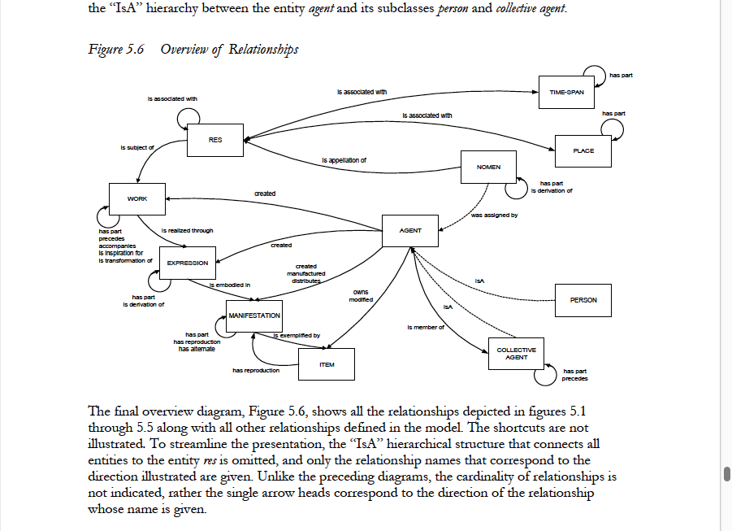
The Model: Overview of Relationship

Slide 11
Conclusion: What it means for UT Libraries? LRM-->RDA-->BIBFRAME
RDA adopted LRM to be its conceptual model to guide the development of RDA (RDA will be an instantiation of LRM)
The first update with LRM in RDA Toolkit is scheduled to be released on June 13, 2018
BIBFRAME continues to develop independently, but it does use RDA as an important source of elements in its vocabulary
BIBFRAME & Alma: Alma can publish its data in the BIBFRAME format since November 2017
Watch for Primo’s development to leverage linked data in Alma

Slide 12
References
IFLA Library Reference Model : A Conceptual Model for Bibliographic Information. August 2017: https://www.ifla.org/files/assets/cataloguing/frbr-lrm/ifla-lrm-august-2017.pdf
Sprochi, Amanda. 2017. The IFLA Library Reference Model and RDA. Presentation. FRBR Interest Group, ALA Annual Conference, Chicago, IL, June 25, 2017.

Slide 13


